Slide 1
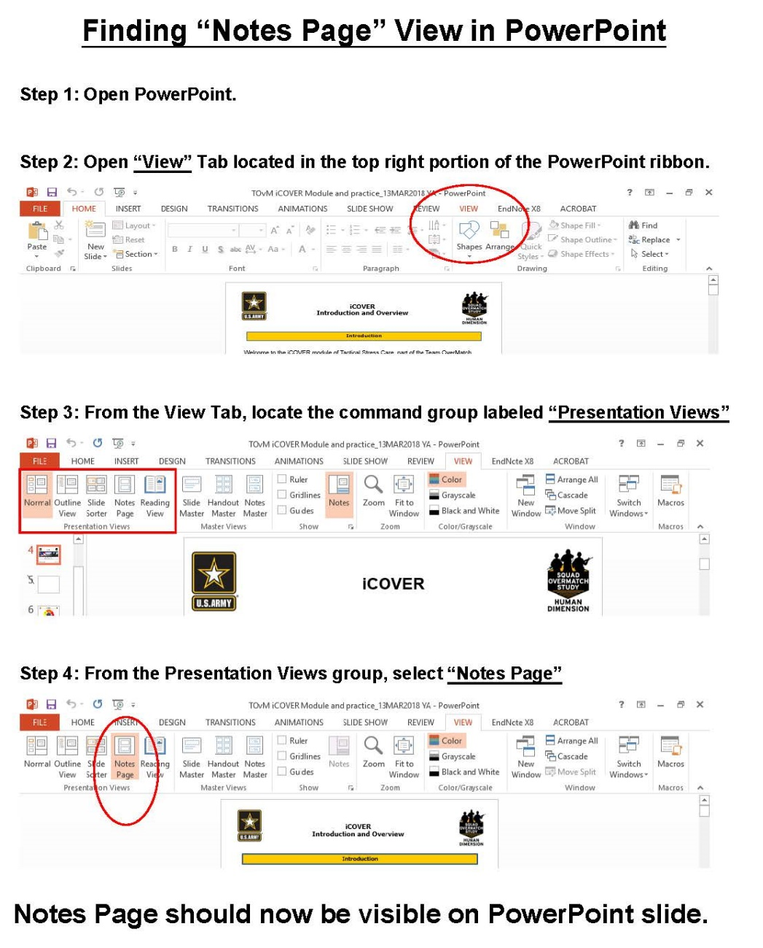
Facilitator Guide: Trainer notes
Notes:
INSTRUCTOR GUIDE
Ask, Care, Escort
Suicide Prevention Training
Base Module
for Circle of Support
ACE Base +1
September 2023
VERSION 1.3

Slide 2
(Hidden)
Notes:
i-A

Slide 3
(Hidden)
Notes:
Introduction
The Army Suicide Prevention Program was instituted by CSA General John A. Wickham in 1984. Since that time, suicide prevention and awareness has evolved. In 2009, Ask, Care, Escort (ACE) training was introduced to update existing suicide prevention training and to respond to a rise in suicide rates.
ACE training introduced suicide prevention and intervention concepts that had proven successful outside of the Army. Its primary goals were to increase suicide awareness and improve the ability of Soldiers to identify team members who may be suicidal and get them to help.
In 2018, ACE training was updated to highlight its use not only during a crisis, but also before one occurs by incorporating Army team building and unit cohesion concepts. This training is aligned with the Center for Disease Control and Prevention's strategic comprehensive public health approach to suicide prevention.
In 2022, the ACE suicide prevention and intervention material was updated yet again and coined ACE Base + 1. The training now consists of a base module along with a menu of “+1” modules that the unit’s command team can choose from based upon the unit’s needs. Together, the base module and the +1 module make up the mandatory one hour of annual suicide prevention and intervention training.
In addition to the tailored training approach, the training is now designed to be more interactive and conversational. In contrast to a traditional “annual briefing,” ACE Base +1 is an “annual conversation” at platoon level where Soldiers in the platoon are able to discuss how they can take care of one another on a human level as it pertains to suicide prevention and intervention.
In 2023, the Army’s suicide prevention and intervention training expanded to include a tailored curriculum for the Soldier’s Circle of Support members. The Soldier’s Circle of Support includes anyone whom the Soldier considers to be a priority within their support system, such as a spouse, significant other, parent, sibling, other family member, mentor, and friend. The intent is that offering Circle of Support members the same knowledge and skills while using the same language and strategies can enable conversation between the Circle of Support member(s) and the Soldier regarding suicide prevention and intervention. What’s more, it can promote effective communication, bolster protective factors like increased cohesion and connection, and increase suicide prevention efforts within the whole Army Family.
i-B
ACE Training for Circle of Support- Base Module

Slide 4
(Hidden)
Notes:
ii-A
Cohesive efforts. It is strongly recommended that this training be offered around the same time frame that their Soldiers receive the ACE Unit Training. According to AR 600-63, ACE suicide prevention and intervention training must be offered to Circle of Support members on an annual basis. The ACE Base for Circle of Support module resembles the content and format of the ACE Base module for Soldiers but has been tailored for members of a Soldier’s Circle of Support (e.g., spouse, significant other, parent(s), siblings, extended family, friends, mentors).
A majority of the examples, discussions, and activities are focused on how a Circle of Support member might apply ACE concepts with their Soldier. The Soldier-focused examples are not to discount the importance of other people (e.g., family members, friends) or relationships that participants have with others; instead, it is done intentionally to keep the training focused on similar learning concepts. Also, it is the most universally relevant focus given every participant attending is there due to having vested interest in a Soldier.
Facilitated discussion and engagement. This training is designed to be facilitated by a single instructor and delivered in an interactive, discussion-based format (rather than conventional lecture or didactic format). Because this module utilizes group interaction, it is highly recommended that it be led by an instructor who is able and willing to elicit participant engagement through facilitating meaningful discussions and practical exercises. The practical exercises are essential in allowing participants the opportunity to try out the Ask, Care, Escort process strategies in a safe, non-threatening environment and develop competence and confidence to use the strategies in real-life scenarios.
Delivered in-person to small groups. The ACE training for Circle of Support is intended to be delivered in person and it is highly recommended that this training be conducted with small groups (fewer than 40). In-person training allows for optimal engagement and also fosters relationship building amidst the participants. For example, new friendships and support networks may be established among those attending this class. There may be circumstances that warrant a virtual training option, however, in order to be realistic and inclusive to all Circle of Support members who wish to participate (e.g., Circle of Support members being geographically scattered, child-care constraints, work schedules). Trainers and command teams are advised to use their discretion to determine the best mode of delivery without compromising its value.
Intent
ACE Training for Circle of Support- Base Module

Slide 5
(Hidden)
Notes:
ii-B
The mention of any non-federal entity and/or its products is not to be construed or interpreted, in any manner, as federal endorsement of that non-federal entity or its products.
Note: Each module should be trained to standard and not to time, it is most effective when time is allowed for in-depth group discussion and participation. To maximize the benefits of this training, allow for extra time for dialogue and interaction.
Training Package Components: The complete “ACE Base +1” training package consists of five PowerPoint® presentations (i.e., ACE Base, Active Listening, Fighting the Stigma, Practicing ACE, Lethal Means) and a SmartGuide with key information to be discussed for each slide (see notes page iv for SmartGuide overview).
Training Precautions: The ACE suicide prevention and awareness training deals with sensitive information and may trigger painful memories or other issues for training participants. It is possible that someone attending the training may have experienced thoughts of suicide or may have experienced a loved one who has struggled with suicidal thoughts, ideation, or worse – died by suicide.
If you are not a chaplain or behavioral health provider, it is recommended that you have someone from the chaplain’s office or Behavioral Health Services on call during your training session. Be sure to coordinate before the training and obtain their name, title, and consent to act as an immediate resource if needed. Provide them with the date, time, and location of the training; on the day of the training, be sure to have the number(s) at which they can be reached or another plan for reaching them.
Training Requirements: The U.S. Army’s requirement for annual suicide prevention training is for Soldiers to complete one hour of training that includes the “ACE Base” module along with one of the “+1” modules, and for the Circle of Support members to be offered annual training as well.
ACE Training for Circle of Support- Base Module

Slide 6
(Hidden)
Notes:
iii-A
Training Preparation:
Content: ACE Training is the U.S. Army’s annual suicide prevention training, which is mandatory for Soldiers (IAW AR 600-63) and to be made available to Circle of Support members. The material is based on the most current research and academic literature on suicide prevention and followed educational best practices. The training is designed to enable the instructor to successfully lead participants through suicide prevention concepts with interactive activities and discussions to prompt critical thinking. For the training to be most effective, it is advised that instructors review all content in advance. Prior to training participants, edit Slide 11 and 15 to include the contact information for local resources.
When instructing, follow the content as written. Insert personal stories/examples as appropriate. Prompts are written into the SmartGuide to highlight times when personal stories/examples can be most valuable. There are many benefits of sharing a personal story or example. For instance, stories/examples can help a trainer to capture the audience’s attention, gain common ground with the audience, and engage the audience on a deeper level. Most importantly, effective use of personal stories or examples can help participants gain better contextual understanding of the material being taught.
The following guidelines can help ensure effective use of personal stories and examples. The story/example
serves a clear purpose, specifically it reinforces the training objective/content
helps participants to gain a better contextual understanding about the concepts
does not distract participants from the focus of training (e.g., be mindful of using potentially triggering or traumatizing examples/stories)
is simple, concise, and easy to follow/understand
Remember, sharing your personal stories/examples is to benefit the participant, not yourself. The story/example should highlight the content, not you as a person (e.g., avoid the mistake of making the training about yourself). Lastly, it is highly recommended that you practice your stories/examples before using them in a training session. Rehearsing the story/example can improve effective delivery, especially if the story/example is one that could be emotional for you to share.
Flow: This training module is comprised of four main sections. At the completion of this module, continue with the chosen “+1” additional module to complete the suicide prevention training requirement IAW AR 600-63.
Introduction & Assessing Risk
Slides 1-6
Protective Factors
Slides 7-9
Risk Factors
Slides 10-13
Warning Signs & Conclusion
+1 Module
Slides 14-18
ACE Training for Circle of Support- Base Module

Slide 7
(Hidden)
Notes:
iii-B
Training Preparation (continued):
Language: Suicide can be an uncomfortable topic to discuss, and it can be difficult to find the words to talk about it. As researchers continue to learn more about suicide and those impacted by it, the language used continues to evolve. For example, the term “committed suicide” perpetuates the idea that suicide is a criminal act, which can be stigmatizing. Instead, consider using the phrases “died by suicide” or “attempted suicide.”
Participants may unintentionally use stigmatizing language, as not everyone understands the harmful impact of these words. It is recommended that during the training, participants are allowed to use the words they feel comfortable with to promote open conversation; however, it is recommended that the instructor supports participant usage of destigmatized language and use those words themselves.
Important concepts: The following analogy helps to clarify the differences between risk factors and warning signs.
Risk factors do not always indicate an emergency but may suggest that a problem is developing. For example, poor diet, lack of exercise, and family history of heart problems if left unchecked increases risk for a heart attack. Similarly, financial distress, relationship issues, and increased isolation if left unchecked increases risk for suicide.
Warning signs indicate that there is a need to take immediate action. For example, signs such as tightness in the chest, tingling arm, flushed face, struggling to breathe—warning signs of a heart attack—clearly show need for intervention. Similarly, signs such as talking about death, giving belongings away, talking about harming oneself, or other significant changes in behavior—warning signs of suicide—clearly show need for intervention.
ACE Training for Circle of Support- Base Module

Slide 8
(Hidden)
Notes:
iv-A
ACE Training Facilitation Strategies
Review the SmartGuide prior to the training session. Take notes on when you may use different facilitation strategies to promote an effective learning experience for participants.
ACE Training for Circle of Support- Base Module

Slide 9
(Hidden)
Notes:
iv-B
ACE Training for Circle of Support- Base Module

Slide 10
(Hidden)
Notes:
v-A
ACE Training for Circle of Support- Base Module

Slide 11
(Hidden)
Notes:
v-B

Slide 12
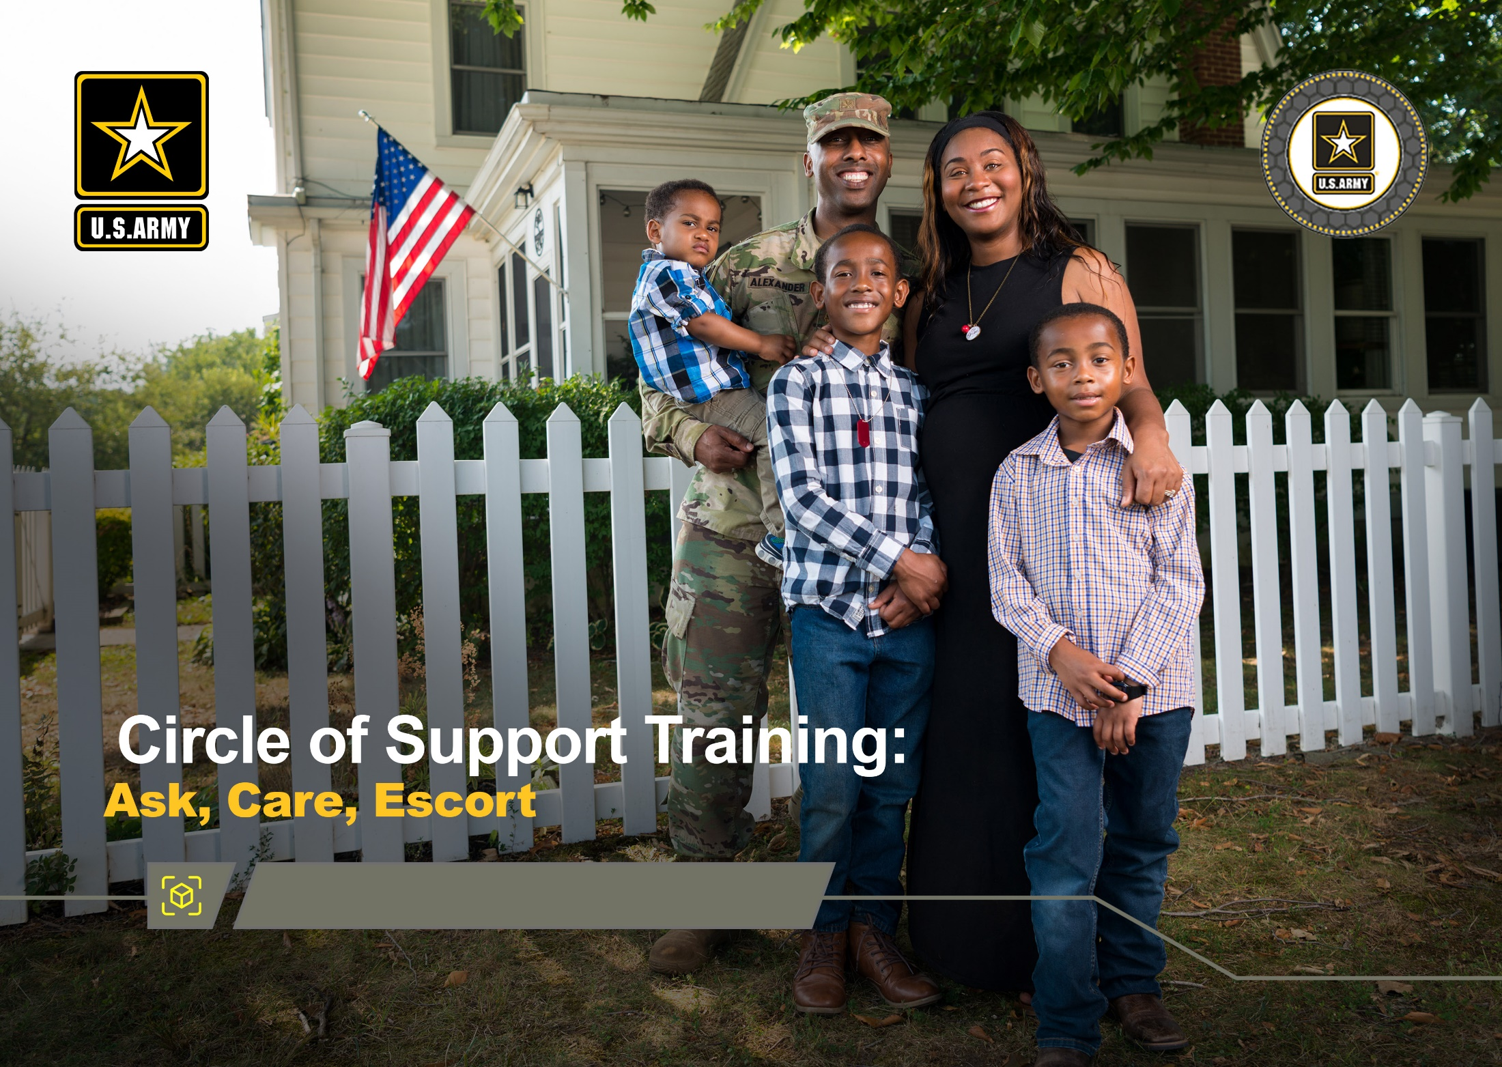
Base Module
DPRR
1
Notes:
Record your own notes here:
1-A
ACE Training for Circle of Support- Base Module

Slide 13
(Hidden)
Notes:
1-B
Record your own notes here:
ACE Training for Circle of Support- Base Module

Slide 14
Impact of Suicide
Impact of Suicide on the Army
One suicide is too many!
Each suicide death impacts ~135 people.
“Every death by suicide is a tragedy that impacts our people, our military units, and our readiness.
That's why we remain committed to a comprehensive and integrated approach to suicide prevention.”
Secretary of Defense Lloyd Austin III Retired U.S. Army four-star general
DPRR
2
Notes:
Record your own notes here:
2-A
ACE Training for Circle of Support- Base Module

Slide 15
(Hidden)
Notes:
2-B
Record your own notes here:
ACE Training for Circle of Support- Base Module

Slide 16
The Army Values and Suicide Prevention
ARMY VALUES
LOYALTY Bear true faith and allegiance to the U.S. Constitution, the Army, your unit, and other Soldiers..
PERSONAL COURAGE
Face fear, danger, or adversity (physical or moral).
How can these Army Values, or your own personal or family values, be leveraged to help reduce suicide risk within your support circle?
HONOR
Live up to the Army Values.
DUTY
Fulfill your obligations.
SELFLESS SERVICE
Put the welfare of the Nation, the Army, and subordinates before your own.
RESPECT
Treat people as they should be treated.
INTEGRITY
Do what’s right, legally and morally.
3
Notes:
3-A
[?]
Record your own notes here:
ACE Training for Circle of Support- Base Module

Slide 17
(Hidden)
Notes:
3-B
Record your own notes here:
ACE Training for Circle of Support- Base Module

Slide 18
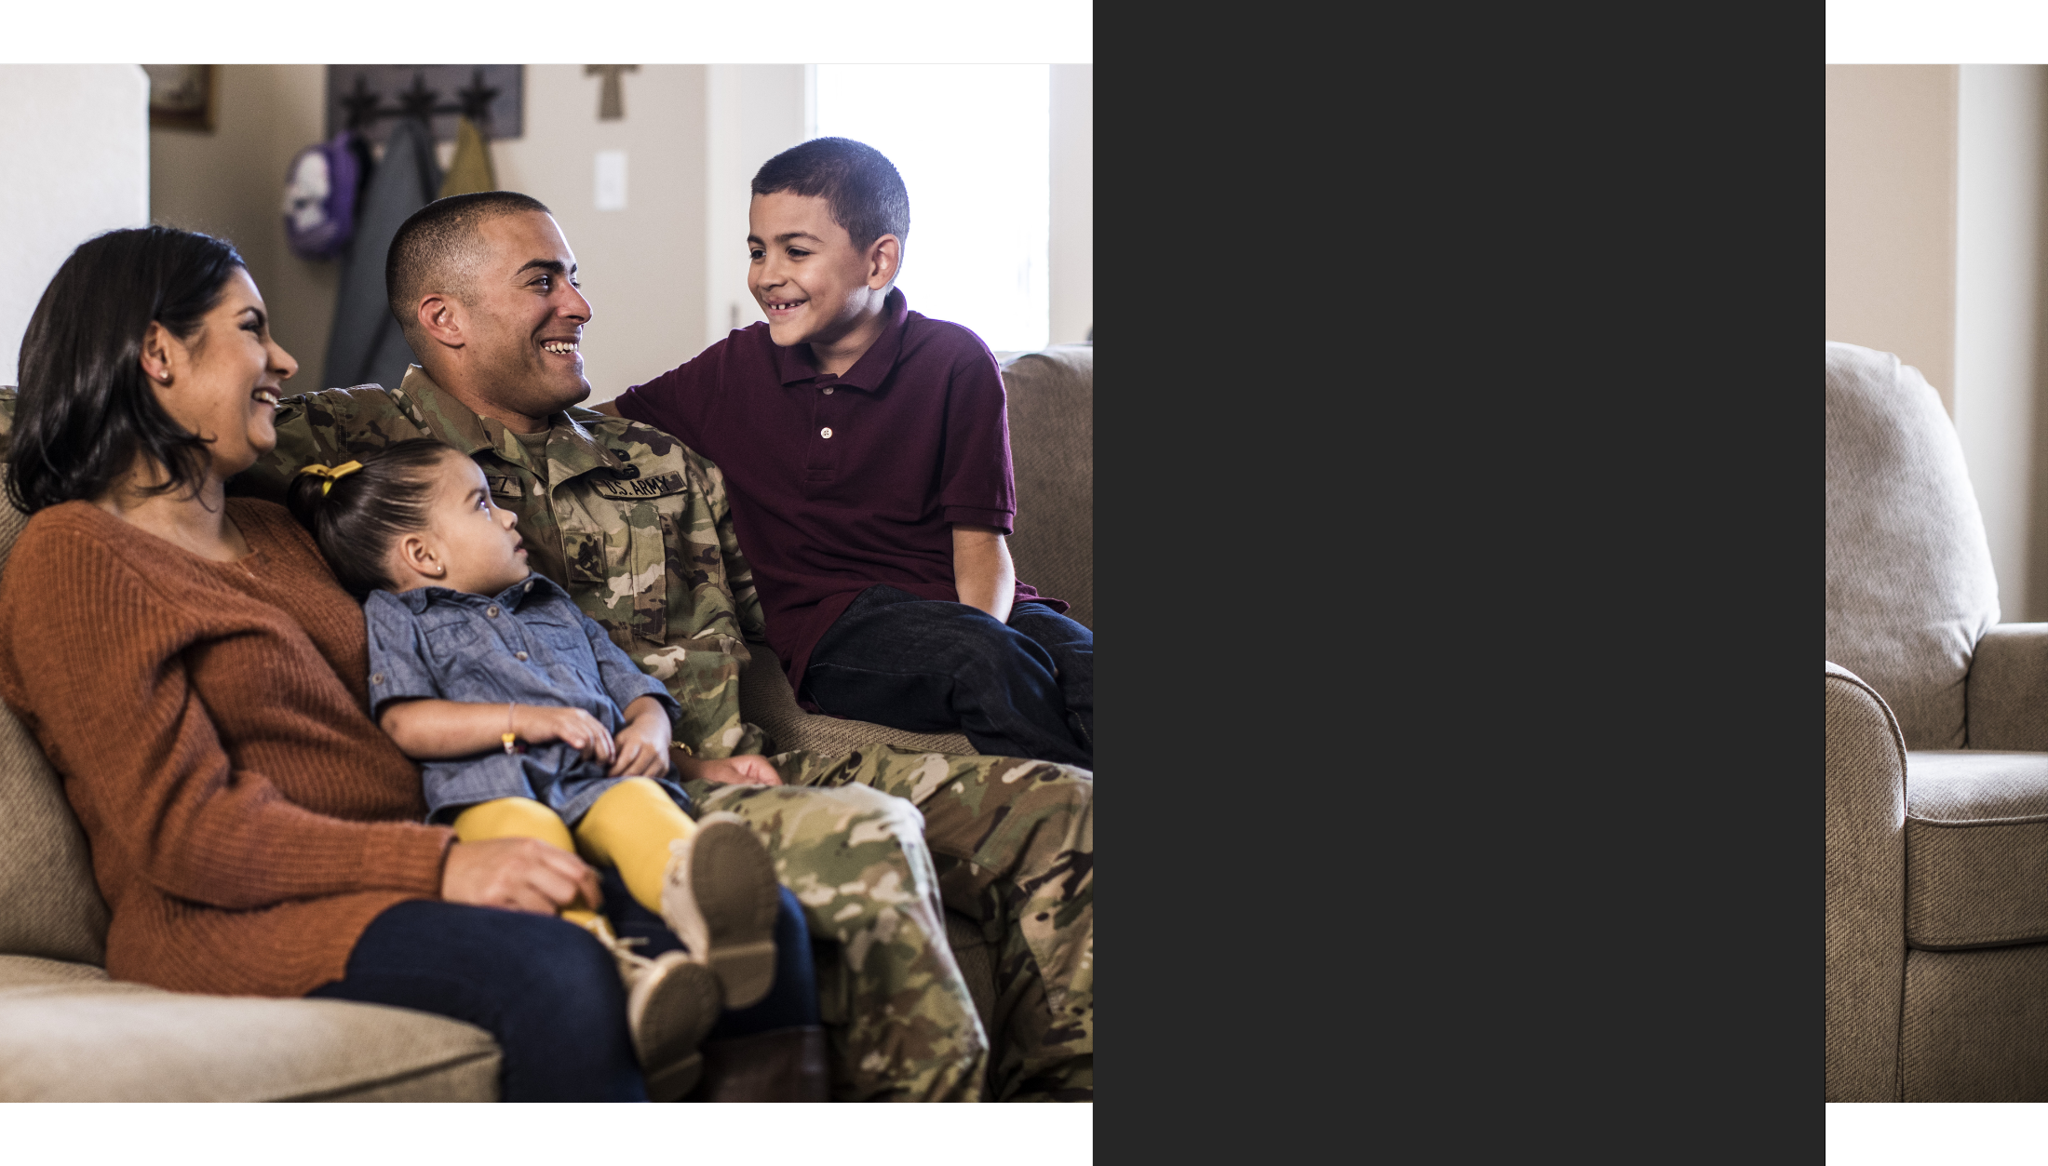
Training Purpose
Training Purpose
To increase awareness of protective factors, risk factors, and warning signs that contribute to a person’s level of risk for suicide
To equip you with specific actions that can be taken to bolster protective factors, mitigate risk, and intervene in a crisis in order to help prevent suicide by utilizing the steps Ask, Care, Escort (ACE)
4
Notes:
Record your own notes here:
4-A
ACE Training for Circle of Support- Base Module

Slide 19
(Hidden)
Notes:
4-B
Record your own notes here:
ACE Training for Circle of Support- Base Module

Slide 20
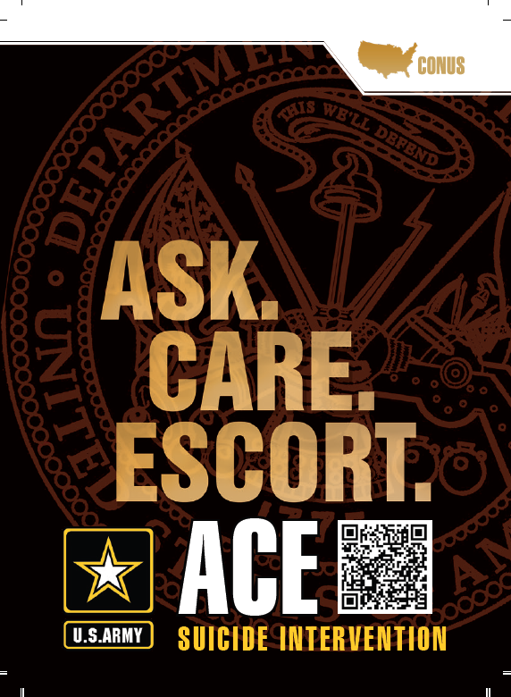
What is Ask, Care, Escort (ACE)?
A - ASK
C - CARE
E - ESCORT
5
Notes:
Record your own notes here:
5-A
ACE Training for Circle of Support- Base Module

Slide 21
(Hidden)
Notes:
5-B
Record your own notes here:
ACE Training for Circle of Support- Base Module

Slide 22
Establish a Baseline
What are some signs or indicators that this person is having an exceptionally good day?
Typical behaviors and moods
Typical reactions to stress or typical coping behaviors
Knowing the BASELINE of those around you is foundational to recognizing change and identifying risk.
6
Notes:
6-A
Record your own notes here:
ACE Training for Circle of Support- Base Module

Slide 23
(Hidden)
Notes:
6-B
Record your own notes here:
ACE Training for Circle of Support- Base Module

Slide 24
Recognize the Signs to Assess Risks
WARNING SIGNS
Time-sensitive concerns for suicide risk
Stop and deal with this NOW
RISK FACTORS
Issues that increase suicide risk
Check in and follow up
PROTECTIVE FACTORS
Behaviors or supports that reduce risk
Encourage healthy behaviors
7
Notes:
Record your own notes here:
[NOTE: IAW ATP 5-19, managing risk is a process of identifying, assessing, and controlling risk arising from a recognized set of factors.]
7-A
ACE Training for Circle of Support- Base Module

Slide 25
(Hidden)
Notes:
7-B
Record your own notes here:
ACE Training for Circle of Support- Base Module

Slide 26
Protective Factors
Protective factors are skills, strengths, or resources that help people deal more effectively with stressful events
To help offset or mitigate risk:
Use productive coping skills
Be willing to talk with others
Utilize professional resources
Connect to a strong sense of purpose
Cultivate strong personal relationships and foster cohesion
What are some examples of protective factors that can help offset or mitigate risk?
8
Notes:
8-A
Record your own notes here:
ACE Training for Circle of Support- Base Module
[?]

Slide 27
(Hidden)
Notes:
8-B
Record your own notes here:
ACE Training for Circle of Support- Base Module

Slide 28
Use ACE to Strengthen Protective Factors
ASK how they are doing or about a specific aspect of their life
Show you CARE by actively listening and show interest in what they share
ESCORT by encouraging proactive use of resources
How can you use each step of ACE to help strengthen connection with your Soldier?
9
Notes:
9-A
[?]
Record your own notes here:
ACE Training for Circle of Support- Base Module

Slide 29
(Hidden)
Notes:
9-B
Record your own notes here:
ACE Training for Circle of Support- Base Module

Slide 30
Protective Factors
You have likely developed skills, strengths, and utilized resources that help you to effectively cope with and overcome challenges.
Everyone still has some level of risk.
Protective factors help decrease the chances that a combination of risk factors result in negative outcomes.
10
Notes:
10-A
Record your own notes here:
ACE Training for Circle of Support- Base Module

Slide 31
(Hidden)
Notes:
10-B
Record your own notes here:
ACE Training for Circle of Support- Base Module
Just like you might consult with a personal trainer or nutritionist to enhance your physical health, there are numerous Army resources, like MWR, Army Community Services, or Strong Bonds, that can assist you in enhancing your protective factors.

Slide 32
Suicide Risk Factors
We all manage life’s challenges differently. How we manage life issues can be protective or can increase our risk for negative outcomes.
We all manage life’s challenges differently. How we manage life issues can be protective or can increase our risk for negative outcomes.
RISK FACTORS
Changes in Behavior:
Avoiding friends or isolating
Dramatic mood changes
Anger or irritability
Anxiety or depression
Inability to sleep
Poor coping mechanisms
Additional Risk Factors:
Family/loved one’s history of suicide
Loss, conflict, or change in relationships
Bullying or discrimination
Job/financial problems or loss
Substance use
Sense of hopelessness
11
Notes:
11-A
Record your own notes here:
ACE Training for Circle of Support- Base Module

Slide 33
(Hidden)
Notes:
11-B
Record your own notes here:
ACE Training for Circle of Support- Base Module

Slide 34
Non-Emergency Resources
Local Resources
General Resources
Army Community Service (ACS): _______________
Military Family Life Counselor (MFLC): _____________
Ready & Resilient Performance Centers (R2PCs)
Army Wellness Center (AWC)
Behavioral Health or Primary Care
Chaplain Services/Local Pastor
Unit Chaplain ________________
Holistic Health & Fitness (H2F) Personnel
American Legion/VFW
Department of Social Services (by state)
Faith-based services or local church
DoD or VA
Military OneSource: 800-342-9647; militaryonesource.mil/; chat via website
Psychological Health Resource Center: 866-966-1020; pdhealth.mil/resources; chat via website
Real Warriors campaign: realwarriors.net; chat via website
My VA 311: 844-MyVA311 (844-698-2311)
Vet Center Call Center: 877-WAR-VETS
Community Resources Guide: crg.amedd.army.mil
Other
Dial 211 or https://www.211.org
Department of Social Services (by state)
What other non-emergency resources do you know of?
12
Notes:
Record your own notes here:
[NOTE: Be sure to add contact information for local resources prior to the training; and be sure to ask the question to participants to offer resources they are aware of or have used that are not represented on the slide.]
12-A
ACE Training for Circle of Support- Base Module

Slide 35
(Hidden)
Notes:
12-B
Record your own notes here:
ACE Training for Circle of Support- Base Module

Slide 36
Use ACE to Mitigate Risks
ASK if they are okay and if you can help
Show you CARE by listening to their problem
ESCORT them to an appropriate helping resource
RISK FACTORS
Anxiety or depression
Inability to sleep
Poor coping mechanisms
Family/loved one’s history of suicide
Being bullied or discriminated against
Loss, conflict, change in relationships
Job/financial problems
Avoiding friends or isolating
Dramatic mood changes
Anger or irritability
Choose a risk factor. How could you use each step of ACE to help your Soldier, loved one, or a person from your Circle of Support to mitigate risk?
13
Notes:
13-A
[?]
Record your own notes here:
ACE Training for Circle of Support- Base Module

Slide 37
(Hidden)
Notes:
13-B
Record your own notes here:
ACE Training for Circle of Support- Base Module

Slide 38
Debrief: Identify and Mitigate Risks
What risk factor did you choose to discuss, and how could you use each step of ACE to help someone mitigate their risk?
When using ACE to mitigate risk, how might that also be strengthening a protective factor?
Using ACE at the sign of concern can stop some problems and stressors from growing and becoming overwhelming to the point of crisis.
14
Notes:
14-A
[?]
Record your own notes here:
ACE Training for Circle of Support- Base Module

Slide 39
(Hidden)
Notes:
14-B
Record your own notes here:
ACE Training for Circle of Support- Base Module

Slide 40
Suicide Warning Signs
There are signs that may indicate someone is contemplating suicide.
WARNING SIGNS
Talking about death
Giving belongings away
Talking about harming oneself
Regularly isolating
Change in behavior
If you see a red flag (a warning sign or a sense something is “off”), take immediate action.
15
Notes:
15-A
Record your own notes here:
ACE Training for Circle of Support- Base Module

Slide 41
(Hidden)
Notes:
15-B
Record your own notes here:
ACE Training for Circle of Support- Base Module

Slide 42
Emergency Resources
Crisis Hotlines
Local Resources
Crisis Hotlines
Local Resources
Your Soldier’s chain of command _____________________
Emergency Room _____________________
Local Emergency Resources
(Dial 9-1-1)
Military Police _____________________
Civilian Police _____________________
ACE-SI
_____________________
Military/Veterans Crisis Line:
North America: Dial 988, Press 1
Text: 838255
Europe: 00800 1-273-8255 or DSN 118
Korea: 0808-555-118 or DSN 118
Veterans Crisis Line Online Chat: www.veteranscrisisline.net/chat
Lifeline Crisis Chat: https://988lifeline.org/chat/
National Suicide Prevention Lifeline: 1-800-273-TALK (8255). Press 1
Suicide Hotlines (by State): http://www.suicide.org/suicide-hotlines.html
OCONUS Emergency Services (911)
Germany: Dial 112
Italy: Dial 112,118
South Korea: Dial 119
16
Notes:
Record your own notes here:
[NOTE: Be sure to add contact information for local resources prior to the training.]
16-A
ACE Training for Circle of Support- Base Module

Slide 43
(Hidden)
Notes:
16-B
Record your own notes here:
ACE Training for Circle of Support- Base Module

Slide 44
Use ACE to Address Warning Signs
ASK directly if they are thinking of killing or harming themselves
CARE by listening and showing support
ESCORT them directly to an emergency helping resource; do not leave them alone
What have you done in the past, or can you do, to stay calm and composed when facing a crisis?
17
Notes:
17-A
[?]
Record your own notes here:
ACE Training for Circle of Support- Base Module

Slide 45
(Hidden)
Notes:
17-B
Record your own notes here:
ACE Training for Circle of Support- Base Module

Slide 46
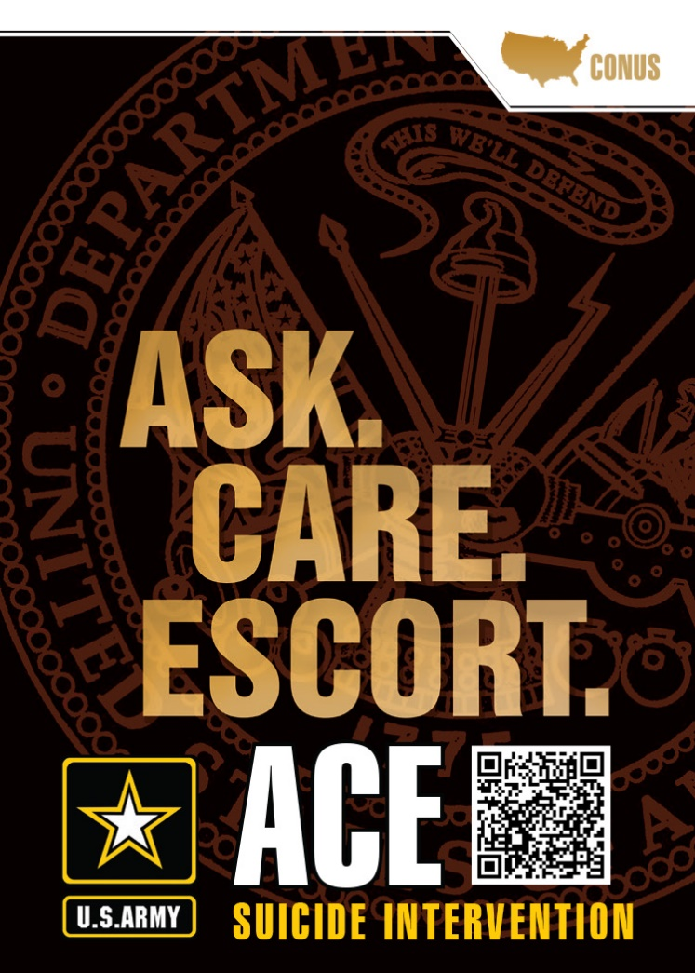
Debrief: Warning Signs
When someone is in crisis, do not leave them alone, especially if they are suicidal.
Taking action when you recognize warning signs shows you CARE; you are bolstering green light protective factors.
18
Notes:
18-A
Record your own notes here:
ACE Training for Circle of Support- Base Module

Slide 47
(Hidden)
Notes:
18-B
Record your own notes here:
ACE Training for Circle of Support- Base Module

Slide 48
Talk with Your Soldier & Each Other
Use ACE to bolster protective factors, mitigate risk, and support your Soldier or loved one in a crisis.
Have a conversation with your Soldier about the training you’ve received.
Share with one another a person that they/you are comfortable confiding in
Discuss which resources they/you want to turn to first
19
Notes:
19-A
Record your own notes here:
ACE Training for Circle of Support- Base Module

Slide 49
(Hidden)
Notes:
19-B
Record your own notes here:
and
ACE Training for Circle of Support- Base Module

Slide 50
You are Equipped to Take Action!
You are now equipped to use ACE to bolster protective factors, mitigate risk, and support your Soldier or loved one in the event of a crisis.
Thank you!
20
Notes:
20-A
Record your own notes here:
ACE Training for Circle of Support- Base Module

Slide 51
(Hidden)
Notes:
20-B
Record your own notes here:
and
ACE Training for Circle of Support- Base Module

Slide 52
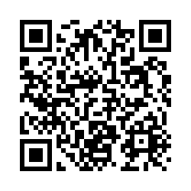
Post-Training Survey
https://wrair.gov1.qualtrics.com/jfe/form/SV_aXFrN0d3WYotIiy
Participants: You have just completed
the ACE Base module.
Completing the survey will assist the DPRR in determining the effectiveness of training and will inform curriculum revisions during the next update cycle.
If you will receive a +1 module after this Base module (i.e, Fighting Stigma, Active Listening, Practicing ACE), please complete the survey at the end of that +1 module.
Notes:
Record your own notes here:
21-A
ACE Training for Circle of Support- Base Module

Slide 53
(Hidden)

Slide 54
(Hidden)
Notes:
22-A
References
Army Publications
Department of the Army. (2015). Army Health Promotion (AR-300-63). https://armypubs.army.mil/epubs/DR_pubs/DR_a/pdf/web/ARN15595_R600_63_admin_FINAL.pdf
Department of the Army. (2019). Army Leadership and the Profession (ADP 6-22). https://armypubs.army.mil/epubs/DR_pubs/DR_a/ARN20039-ADP_6-22-001-WEB-0.pdf
Department of the Army. (2015). Army Team Building (ATP 6-22.6). https://armypubs.army.mil/epubs/DR_pubs/DR_a/pdf/web/atp6_22x6%20FINAL.pdf
Department of the Army. (2016). A Leader’s Guide to Soldier Health and Fitness (ATP 6-22.5). https://armypubs.army.mil/epubs/DR_pubs/DR_a/pdf/web/atp6_22x5.pdf
Department of the Army. (2015). Health Promotion, Risk Reduction, and Suicide Prevention (DA PAM 600- 24). https://armypubs.army.mil/epubs/DR_pubs/DR_a/pdf/web/p600_24.pdf
Other Publications
Bowersox, N. W., Jagusch, J., Garlick, J., Chen, J. I., & Pfeiffer, P. N. (2021). Peer-based interventions targeting suicide prevention: A scoping review. American Journal of Community Psychology, 68(1- 2), 232–248. https://doi.org/10.1002/ajcp.12510
Defense Suicide Prevention Office. (2016). Suicide Prevention Training Competency Framework: A competency framework for all members and targeted sub-groups across the Department of Defense. https://www.dspo.mil/Portals/113/Documents/Final%20Signed%20Competency%20 Framework%202016.pdf?ver=2018-02-07-111806-747
Department of Defense. (2020). Annual Suicide Report Calendar Year 2019 (Ref ID. 4-CFF293C). https://www.dspo.mil/Portals/113/Documents/CY2019%20Suicide%20Report/DoD%20Calendar%2 0Year%20CY%202019%20Annual%20Suicide%20Report.pdf
Drollinger, T., Comer, L. B., & Warrington, P. T. (2006). Development and validation of the active empathetic listening scale. Psychology & Marketing, 23(2), 161-180. https://doi.org/10.1002/mar.20105
Griffith, J. & Bryan, C. J. (2018). Preventing suicides in the U.S. Military. Psychological Services, 15(3), 251- 261. http://dx.doi.org/10.1037/ser0000225
Hangartner, R. B., Totura, C. M. W., Labouliere, C. D., Gryglewicz, K., & Karver, M. S. (2019). Benchmarking the "Question, Persuade, Refer" Program Against Evaluations of Established Suicide Prevention Gatekeeper Trainings. Suicide & Life-Threatening Behavior, 49(2), 353–370. https://doi.org/10.1111/sltb.12430
Litteken, C., & Sale, E. (2018). Long-Term Effectiveness of the Question, Persuade, Refer (QPR) Suicide Prevention Gatekeeper Training Program: Lessons from Missouri. Community Mental Health Journal, 54(3), 282–292. https://doi.org/10.1007/s10597-017-0158-z
ACE Training for Circle of Support- Base Module

Slide 55
(Hidden)
Notes:
22-B
References (cont.)
Nock, M. K., Deming, C. A., Fullerton, C. S., Gilman, S. E., Goldenberg, M., Kessler, R. C., McCarroll, J. E., McLaughlin, K. A., Peterson, C., Schoenbaum, M., Stanley, B., & Ursano, R. J. (2013). Suicide among soldiers: a review of psychosocial risk and protective factors. Psychiatry, 76(2), 97–125. https://doi.org/10.1521/psyc.2013.76.2.97
Peterson, A. L., Monahan, M. F., Bender, A. M., Gryglewicz, K., & Karver, M. S. (2021). Don't Invite Everyone! Training Variables Impacting the Effectiveness of QPR Trainings. Administration and Policy in Mental Health, 48(2), 343–353. https://doi.org/10.1007/s10488-020-01078-3
Pietrzak, R. H., Johnson, D. C., Goldstein, M. B., Malley, J. C., Rivers, A. J., Morgan, C. A., & Southwick, S. M. (2010). Psychosocial buffers of traumatic stress, depressive symptoms, and psychosocial difficulties in veterans of Operations Enduring Freedom and Iraqi Freedom: the role of resilience, unit support, and postdeployment social support. Journal of Affective Disorders, 120(1-3), 188–192. https://doi.org/10.1016/j.jad.2009.04.015
Rosa, L. (2014). Reach Out! Suicide prevention using QPR (Question, Persuade, Refer). Louisiana Bar Journal, 62(4), 267. https://www.lsba.org/documents/publications/BarJournal/Journal-Dec14- Jan15.pdf
Rudd, M. D., Berman, A. L., Joiner, T. E., Jr, Nock, M. K., Silverman, M. M., Mandrusiak, M., Van Orden, K., & Witte, T. (2006). Warning signs for suicide: theory, research, and clinical applications. Suicide & Life-Threatening Behavior, 36(3), 255–262. https://doi.org/10.1521/suli.2006.36.3.255
Science and Technology Organization. (2018). Military suicide prevention: Report prepared for NATO leadership (Report No. STO-TR-HFM-218). North Atlantic Treaty Organization. https://apps.dtic.mil/sti/pdfs/AD1062460.pdf
Trachik, B., Tucker, R. P., Ganulin, M. L., Merrill, J. C., LoPresti, M. L., Cabrera, O. A., & Dretsch, M. N. (2020). Leader provided purpose: Military leadership behavior and its association with suicidal ideation. Psychiatry Research, 285, 112722. https://doi.org/10.1016/j.psychres.2019.112722
ACE Training for Circle of Support- Base Module

